Slide 1

311 Service Requests Analysis in New York City
Presented by:
Jane Liang
Weiqiang He
Yiqing Qian

Slide 2
CONTENTS
Introduction
Project Scope
Data Set
Hardware Specification
Workflow
Main Queries
Data Visualizations
Summary
Limitations
GitHub
Reference

Slide 3
INTRODUCTION
Launched in 2003
311 is a 24/7 non-emergency phone number
Mission - To make government services accessible for all
How to access - phone, app, social media, nyc.gov/311

Slide 4

PROJECT SCOPE
10 years New York City 311 service request dataset
Using SCP command to copy dataset to the Cluster, then moved the dataset into hadoop distributed file system (HDFS)
Using AWS Cloud and HIVEQL to analyze data
Using Tableau and Excel to perform data visualization

Slide 5
DATA SET -
New York City 311 Service Request
Dataset from NYC Open Data
Dataset URL: https://data.cityofnewyork.us/Social-Services/311-Service-Requests-from-2010-to-Present/erm2-nwe9
Dataset range: 01/01/2010 to 10/31/ 2019
Dataset size: 11.6GB
Dataset columns: 41, which include: Unique Key, Created Date, Closed date, Agency, Complaint Type, Incident Zip, Latitude, Longitude and so on.
Data rows: around 22 million

Slide 6
HARDWARE SPECIFICATION
AWS EMR Specification:
Cluster IP: | 34.221.40.43
Number of Nodes in Cluster: | 3
Release Label : | Emr-5.27.0
Hadoop Distribution: | Amazon 2.8.5
Applications: | Hive 2.3.5
Core Number of CPU: | 2 Cores (4 vCPU)
CPU Speed: | 2.5 GHz
Memory | 15 GiB
Instance Storage | 2 x 40 GB

Slide 7
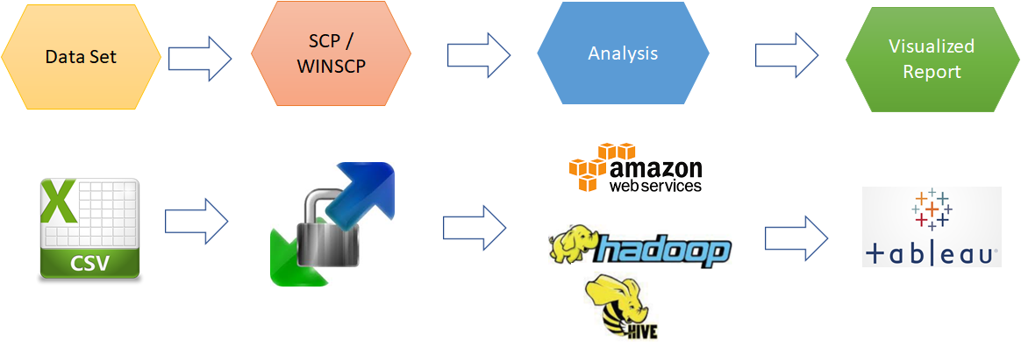

WORKFLOW
Notes:
Steps:
Download the dataset from website
Upload the dataset (csv file) to AWS cluster (34.221.40.43) by SCP
Move the dataset file to hadoop distributed file system by the SCP command
Create External table in Hive based on the dataset in hadoop file system
Conduct analysis by queries using HiveQL

Slide 8
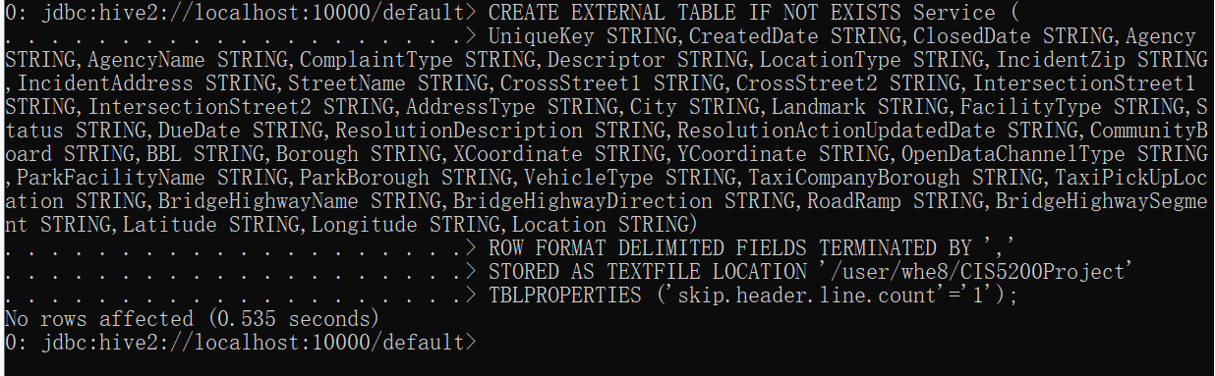
MAIN QUERIES -
HiveQL Statement to Create External Table
CREATE EXTERNAL TABLE IF NOT EXISTS Service (
UniqueKey STRING,
CreatedDate STRING,
ClosedDate STRING,
Agency STRING,
AgencyName STRING,
ComplaintType STRING,
Descriptor STRING,
LocationType STRING,
IncidentZip STRING,
IncidentAddress STRING,
StreetName STRING,
CrossStreet1 STRING,
CrossStreet2 STRING,
IntersectionStreet1 STRING,
IntersectionStreet2 STRING,
AddressType STRING,
City STRING,
Landmark STRING,
FacilityType STRING,
Status STRING,
DueDate STRING,
ResolutionDescription STRING,
ResolutionActionUpdatedDate STRING,
CommunityBoard STRING,
BBL STRING,
Borough STRING,
XCoordinate STRING,
YCoordinate STRING,
OpenDataChannelType STRING,
ParkFacilityName STRING,
ParkBorough STRING,
VehicleType STRING,
TaxiCompanyBorough STRING,
TaxiPickUpLocation STRING,
BridgeHighwayName STRING,
BridgeHighwayDirection STRING,
RoadRamp STRING,
BridgeHighwaySegment STRING,
Latitude STRING,
Longitude STRING,
Location STRING)
ROW FORMAT DELIMITED FIELDS
TERMINATED BY ','
STORED AS TEXTFILE LOCATION '/user/whe8/CIS5200Project'
TBLPROPERTIES ('skip.header.line.count'='1');

Slide 9
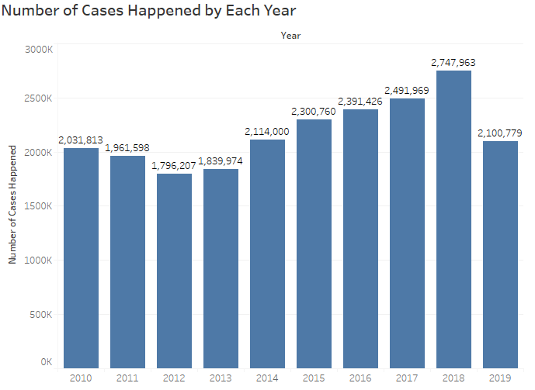
DATA VISUALIZATIONS
#1 Number of Cases per Year
Through this bar chart, we can see how many complaint cases happened in each year. Number of cases is in a trend of going up by year.
MAX:
In 2018------2,747,963 case, 13% of total cases.
MIN:
In 2012------1,796,207 cases, 8% of total cases.

Slide 10
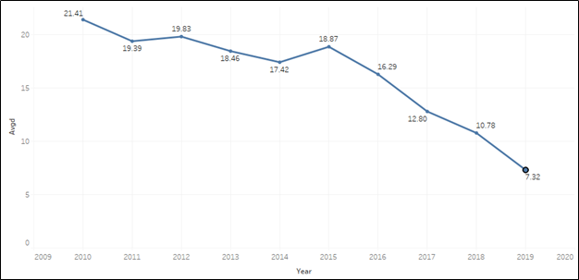
DATA VISUALIZATIONS
#2 Average Days Taken to Close the case
Average days to close the case:
MAX: 21.41 days for 2010
MIN: 7.32 days for 2019
The line chart shows that the trend for average days taken to close each case is decreasing yearly.

Slide 11
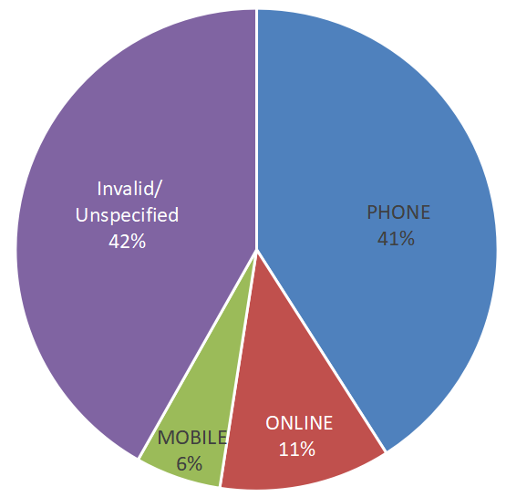
DATA VISUALIZATIONS
#3 Channel Type by Percentage
Through this pie chart, we analyze that a majority of people usually use their phones (call center) to request 311 service.
Note: Phone: call center Mobile: mobile app
Online: 311 service website

Slide 12
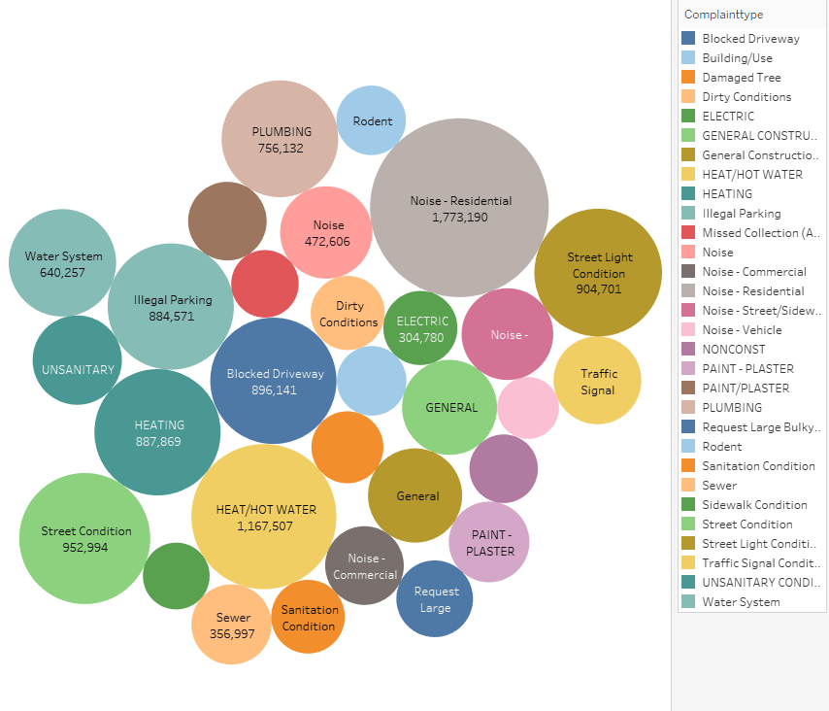
DATA VISUALIZATIONS
#4-1 Number of Cases for Each Complaint Type
This packed Bubble chart shows that the most common complaint types are :
Noise-Residential
Heat/ hot water
Street condition
Heating
Blocked driveway
Street light condition
Notes:
In this packed Bubble chart, the number of case for one complaint type is higher, then the bubble size is bigger.

Slide 13
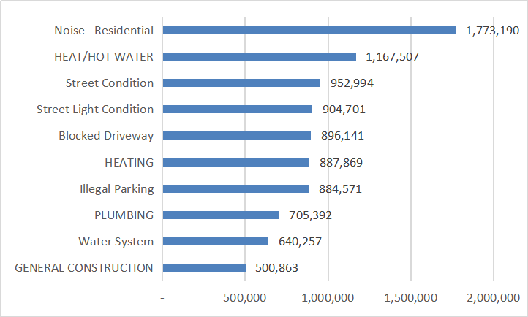
DATA VISUALIZATIONS
#4-2 Top 10 by Complaint Type
The cases number for top 10 complaint types accounts for 43% of total case number(21.8m)
Notes:
The cases number for top 10 complaint type accounts for 43% of total case number(21.8m)

Slide 14
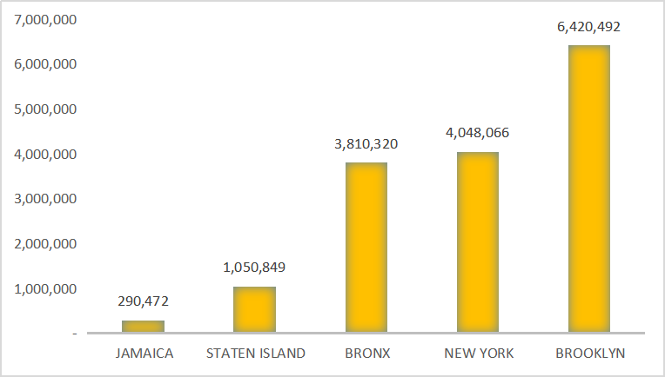
DATA VISUALIZATIONS
#5 Top 5 Cities by Total Case Numbers
Brooklyn, New York, and Bronx have the most significant complaint case numbers, which accounts for 66% of all complaints (21.8 m) in the past 10 years.

Slide 15
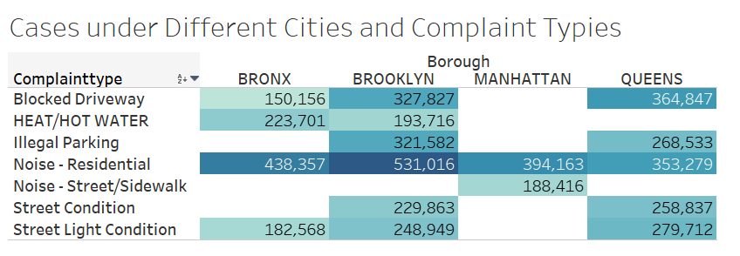
DATA VISUALIZATIONS
#6 Number of Cases in Different Borough and Complaint Type
Different boroughs have different major complaint types.
Through this table, we can see Brooklyn has the most cases in noise-residential complaint.
Condition: the total number of cases greater than 150,000 for major borough and complaint type.

Slide 16
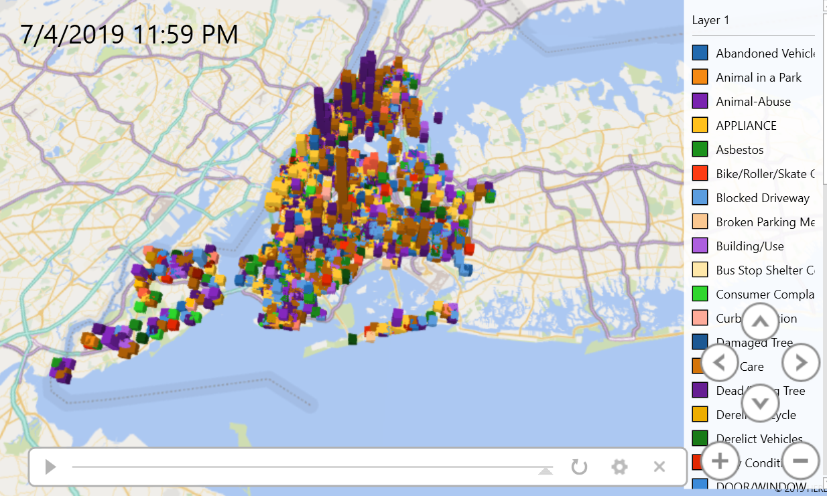
DATA VISUALIZATIONS
#7 Complaint Distribution on July 4th, 2019
Through this map, we can see that distribution of complaints happened in New York Area on the Independence Day of 2019 by time.
Video link:
https://youtu.be/6WULXFWI598

Slide 17
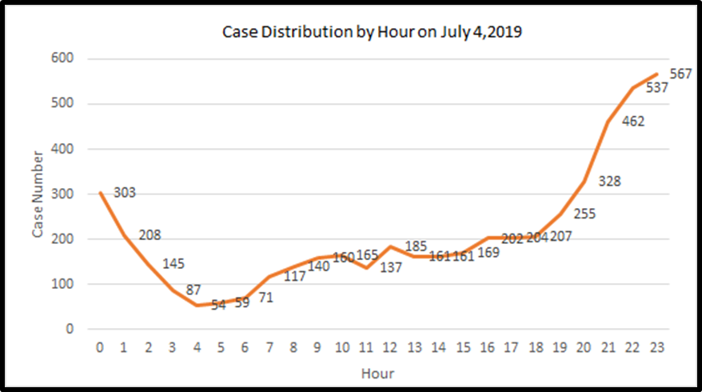
DATA VISUALIZATIONS
#8 Complaint Case by Hour on July 4th, 2019
This is to visualize the case distribution by each hour on July 4, 2019. It shows that more cases were reported in night from 8:00PM to 1:00AM, and less cases were reported in earlier morning from 3:00AM to 7:00AM.
(0 represents the period from 0-1, while 23 represents the period from 23-24.)

Slide 18
SUMMARY
Total number of cases is increasing year by year, with 2018 hit the most cases, 2,747,963
Agencies have improved their efficiency to decrease the average days to close each case
Making phone calls is the most common channel to request 311 service
Residential noise ranks #1 most common complaints
Most complains happened in Brooklyn and New York City

Slide 19
LIMITATIONS
The data in the dataset is not clear enough and our analysis might not reflect the real situation.
For example:
For case closed date: A lot of cases have invalid closed date (619,420 cases with empty closed date, 5986 cases with closed date in year 1900)
For the complaint channel: 42% of cases were unspecified or invalid

Slide 20
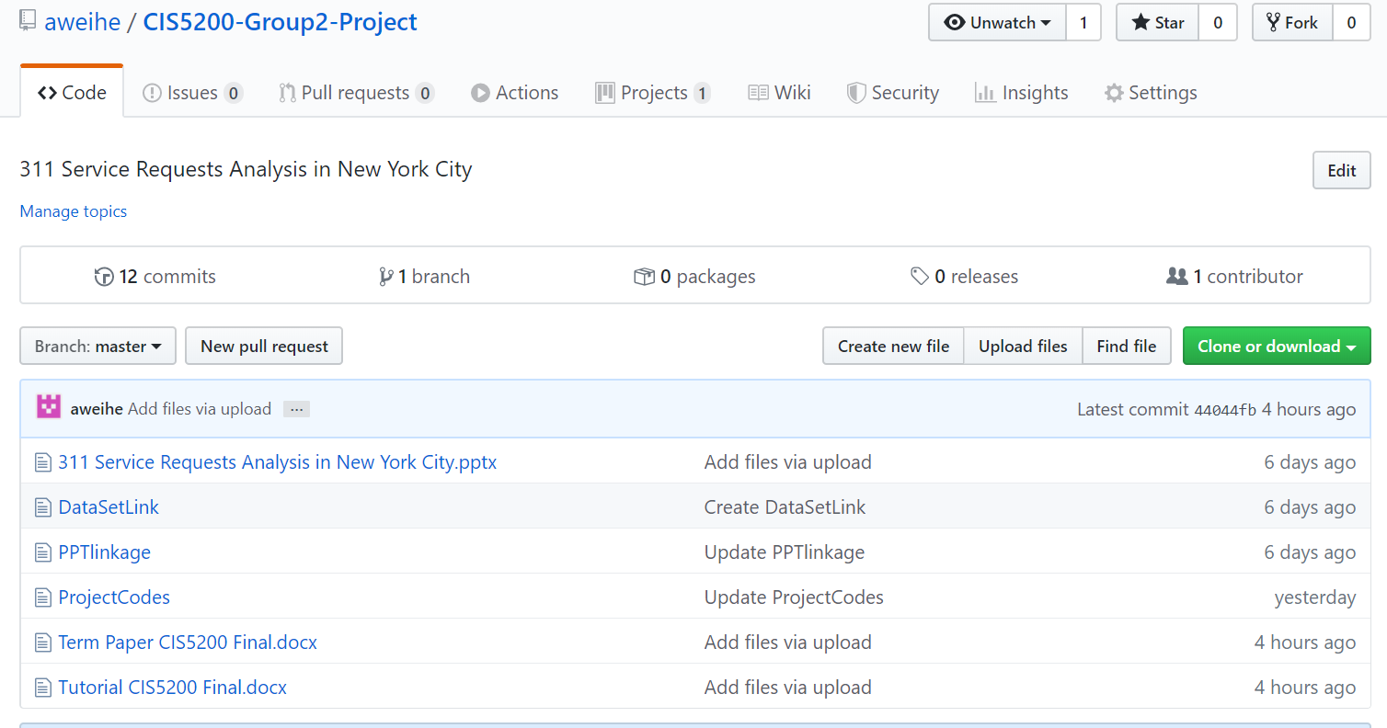
GITHUB
GitHub Link: https://github.com/aweihe/CIS5200-Group2-Project/tree/master

Slide 21
REFERENCE
https://council.nyc.gov/data/311-services/
https://portal.311.nyc.gov/

Slide 22

THANK YOU

